Slide 1
A Multi-State Constraint Kalman Filter for Vision-aided Inertial Navigation
Paper By: Anastasios I. Mourikis and Stergios I. Roumeliotis
Presented By: Matthew Duffell-Hoffman
Notes:
A Multi-State Constraint Kalman Filter
for Vision-aided Inertial Navigation
Referred to as MSCKF
Paper By:
Anastasios Mourikis and
Stergios Roumeliotis
Presented By: Matthew Duffell-Hoffman

Slide 2
Outline
Introduction
EKF Review
MSCKF Estimator Description
  Overview
  State Vector
  EKF Propagation
  State Augmentation
  Measurement Model (Primary Contribution)
  EKF Update
Discussion
Experimental Results
Notes:
Outline
Introduction
EKF Review
MSCKF Estimator Description
Overview
State Vector
EKF Propagation
State Augmentation
Measurement Model (Primary Contribution)
EKF Update
Discussion
Experimental Results

Slide 3
Introduction

Slide 4
Motivation
Problem: Localization
GPS is unreliable or unavailable in some environments
Inertial Measurement Units (IMUs) and cameras are small, inexpensive, and have low power consumption
Fused IMU and camera measurements can provide very accurate pose estimates
Notes:
Motivation
Problem: Localization
What is the robot pose and trajectory
GPS is unreliable or unavailable in some environments
Such as indoors or underwater
Inertial Measurement Units (IMUs) and
cameras are small, inexpensive, and have low power consumption
Fused IMU and camera measurements can provide very accurate pose estimates
MSCKF will use monocular camera and IMU

Slide 5
Two Families of Algorithms for VINS
VIO
SLAM
Estimates robot pose only
Typically derives constraints between consecutive pairs of images
Efficient, good for real-time applications
Jointly estimates robot pose and landmark positions
Accounts for correlations between robot pose and 3D positions of observed features
High computational complexity
Notes:
Two Families of Algorithms for VINS
Looked at examples of both
Visual inertial odometry
Like Anzhelika
Estimates robot pose only
Typically derives constraints between
consecutive pairs of images
Efficient, good for real-time applications
Simultaneous localization and mapping
Jointly estimates robot pose and landmark positions
Accounts for correlations between
robot pose and 3D positions of observed features
High computational complexity
Some global optimization methods are
Highly accurate but offline like graph slam
presented by Keith and Malcom
not suitable for real-time localization
key frame approach presented by
Ibrahim discards possible information to reduce complexity

Slide 6
Characteristics of MSCKF
Extended Kalman Filter
Uses both visual and inertial measurements
Does not include 3D feature positions Inn state vector
Expresses constraints between multiple camera poses when a feature can be seen in more than two images
Delayed linearization
Linear complexity in number of features
Notes:
Characteristics of MSCKF
Extended Kalman filter
Uses both visual and inertial measurements
Does not include 3D feature positions Inn state vector
Expresses constraints between multiple camera poses when
a feature can be seen in more than two images
Delayed linearization
Linear complexity in number of features

Slide 7
EKF Review

Slide 8
Kalman Filter
Tracks the estimated state of the system and covariance (uncertainty)
Assumptions:
  Linear process and measurement models
  Gaussian process and measurement noise
  Markov assumption, each state depends only on the previous state
Two parts:
  Propagate – updates estimate based on system dynamics, increases uncertainty
  Update – updates estimate based on observations, decreases uncertainty
Extended Kalman Filter (EKF) allows for non-linear system by linearizing around the state estimate
Notes:
Kalman filter
Tracks the estimated state of the
system and covariance (uncertainty)
Assumptions:
Linear process and measurement models
Gaussian process and measurement noise
Markov assumption, each state depends only on the previous state
Algorithm has Two parts:
Propagate – updates estimate based on
system dynamics, increases uncertainty
Update – updates estimate based on
Observations decreases uncertainty
remember that propagation and update
can happen independently
MSCKF uses IMU for propagation and
Camera for update so many propagations between updates
Non-linear system, differentiable not linear
Extended Kalman filter EKF linearizes around state estimate

Slide 9
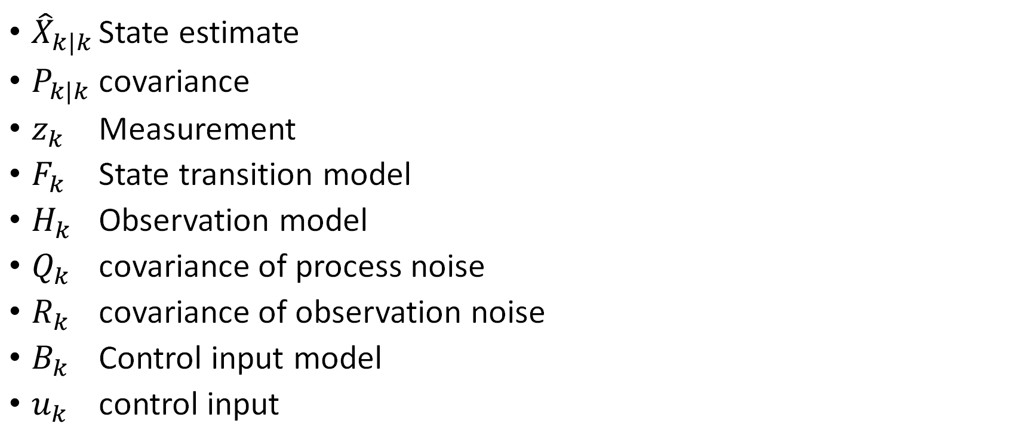
Kalman Filter Quantities
${\hat{X}}_{k|k}$ State estimate
$P_{k|k}$ covariance
$z_{k}$ Measurement
$F_{k}$ State transition model
$H_{k}$ Observation model
$Q_{k}$ covariance of process noise
$R_{k}$ covariance of observation noise
$B_{k}$ Control input model
$u_{k}$ control input
Notes:
Kalman filter Quantities
Fast, okay if you don’t remember all
X hat is state estimate
P is covariance
Z is a measurement
F is the state transition model
H is the observation model
Q is covariance of process noise
R is covariance of observation noise
Sometimes B is control input model
U is control input
MSCKF does not use B and U

Slide 10
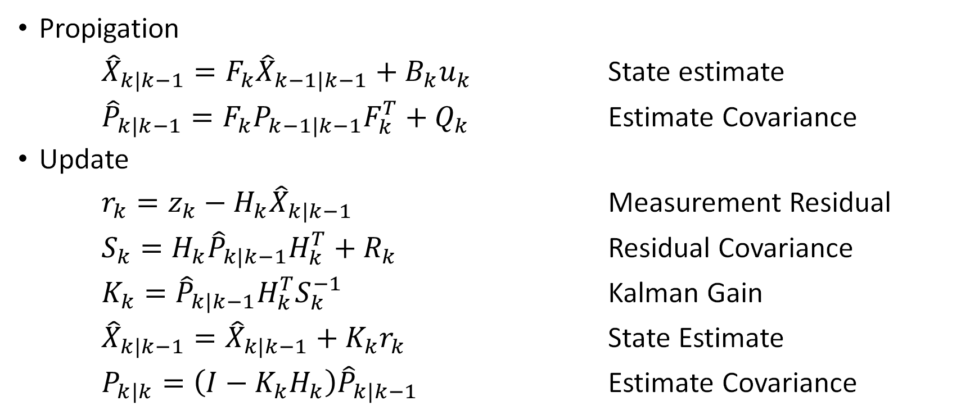
Kalman Filter Equations
Propigation
${\hat{X}}_{k|k−1}=F_{k}{\hat{X}}_{k−1|k−1}+B_{k}u_{k}$ State estimate
${\hat{P}}_{k|k−1}=F_{k}P_{k−1|k−1}F_{k}^{T}+Q_{k}$ Estimate Covariance
Update
$r_{k}=z_{k}−H_{k}{\hat{X}}_{k|k−1}$ Measurement Residual
$S_{k}=H_{k}{\hat{P}}_{k|k−1}H_{k}^{T}+R_{k}$ Residual Covariance
$K_{k}={\hat{P}}_{k|k−1}H_{k}^{T}S_{k}^{−1}$ Kalman Gain
${\hat{X}}_{k|k−1}={\hat{X}}_{k|k−1}+K_{k}r_{k}$ State Estimate
$P_{k|k}=\left(I−K_{k}H_{k}\right){\hat{P}}_{k|k−1}$ Estimate Covariance
Notes:
Kalman Filter Equations
First is propagation
State estimate is propagated by applying
The state transition model to previous state and
Adding influence from control signals
Covariance is propagated by applying the
State transition model to the previous covariance and
Added the uncertainty from the process model
Again, this increases uncertainty in estimate
Second step is update
First calculate residual buy taking
The expected observation given the current estimated state
Which is the observation model applied to the estimated state
And subtract it from the actual measurement taken
Then the residual covariance is the
observation model applied to
The estimate covariance which has been propagated
And adding the uncertainty of the observation model
The Kalman gain is calculated from the
Covariance, observation model, and residual covariance
This is a scaling factor to tell us how much to correct
Based on the uncertainty of the observation
Finally, the state estimate is updated by
Adding the residual scaled by the Kalman gain To
the current estimate
And the covariance is updated
By the Kalman gain and observation model
Again, this decreases the uncertainty

Slide 11
MSCKF Estimator Description

Slide 12
Overview

Slide 13
Frames of Reference
Goal of MSCKF is to track the 3D pose of the IMU affixed frame {I} with respect to the global frame {G}
{G} is an Earth-centered, Earth-fixed frame to simplify effects of Earth’s rotation on IMU measurements
Notes:
Frames of Reference
Goal of MSCKF is to track the
3D pose of the IMU affixed frame {I}
with respect to the global frame {G}
{G} is an Earth-centered, Earth-fixed frame
to simplify effects of Earth’s rotation on IMU measurements

Slide 14
MSCKF Algorithm
Propagation: For each IMU measurement received, propagate the filter state and covariance.
Image registration: Every time a new image is recorded,
  augment the state vector and covariance matrix with a copy of the current camera pose estimate.
  image processing module begins operation.
Update: When the feature measurements of a given image become available, perform an EKF update.
Notes:
High level MSCKF Algorithm
EKF which includes camera poses in the state vector
Propagation: For each IMU measurement received,
propagate the filter state and covariance.
Image registration: Every time a new image is recorded,
augment the state and covariance
with a copy of the current camera pose estimate.
image processing module begins operation.
Update: When the feature measurements
of a given image become available,
perform an EKF update.

Slide 15
State Vector

Slide 16
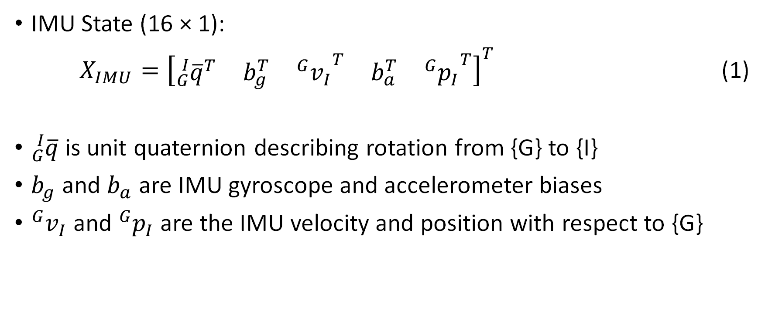
IMU State Vector
IMU State (16 × 1):
$X_{IMU}={\left[\begin{matrix}{{}_{G}^{I}{\overline{q}}}^{T} & b_{g}^{T} & {{}_{ }^{G}{v_{I}}}^{T} & b_{a}^{T} & {{}_{ }^{G}{p_{I}}}^{T}\end{matrix}\right]}^{T}$ (1)
${}_{G}^{I}{\overline{q}}$is unit quaternion describing rotation from {G} to {I}
$b_{g}$ and $b_{a}$ are IMU gyroscope and accelerometer biases
${}_{ }^{G}{v_{I}}$ and ${}_{ }^{G}{p_{I}}$ are the IMU velocity and position with respect to {G}
Notes:
IMU State vector
Note on notation, you’ll see transposes Everywhere, this is showing
column vectors written as row vectors for space
IMU state is column vector containing
Q is unit quaternion describing
rotation from {G} to {I}
B G and B A are
IMU gyroscope and accelerometer biases modeled as random walk processes
V I and P I are
the IMU velocity and position with respect to {G}

Slide 17
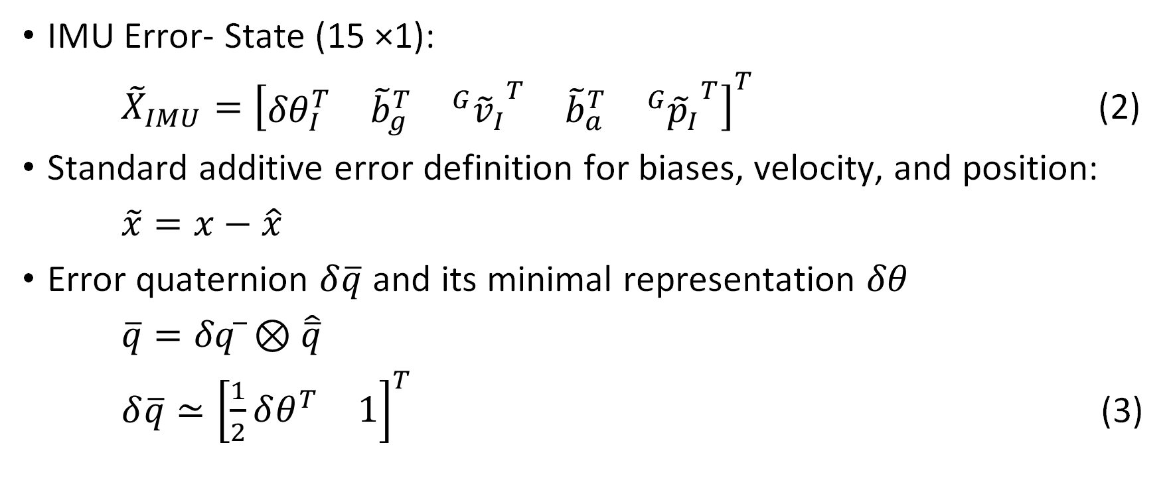
IMU Error –State Vector
IMU Error- State (15 ×1):
${\tilde{X}}_{IMU}={\left[\begin{matrix}{δθ}_{I}^{T} & {\tilde{b}}_{g}^{T} & {{}_{ }^{G}{{\tilde{v}}_{I}}}^{T} & {\tilde{b}}_{a}^{T} & {{}_{ }^{G}{{\tilde{p}}_{I}}}^{T}\end{matrix}\right]}^{T}$ (2)
Standard additive error definition for biases, velocity, and position:
$\tilde{x}=x−\hat{x}$
Error quaternion $δ\overline{q}$ and its minimal representation $δθ$
$\overline{q}=δq ̅⊗\hat{\overline{q}}$
$δ\overline{q}≃{\left[\begin{matrix}\frac{1}{2}δθ^{T} & 1\end{matrix}\right]}^{T}$ (3)
Notes:
IMU error state vector
Error state vector for IMU is this column vector
The biases velocity and position have standard error definition
Where the error is the true value minus the estimated value
For attitude error we use delta theta
Which comes from the error quaternion delta q
Which is the small rotation applied to the estimate
To make it equal the true value
Error quaternion approximated by delta theta
Which is the minimal representation since 3 degrees of freedom
They Do not explain approximation in paper

Slide 18
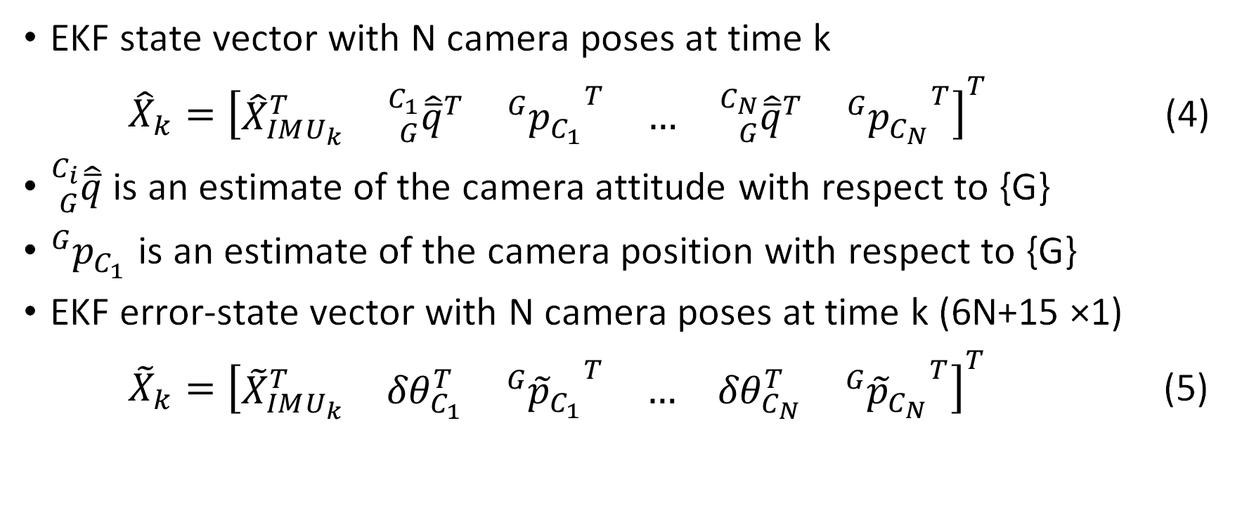
EKF State Vector
EKF state vector with N camera poses at time k
${\hat{X}}_{k}={\left[\begin{matrix}{\hat{X}}_{IMU_{k}}^{T} & {{}_{G}^{C_{1}}{\hat{\overline{q}}}}^{T} & {{}_{ }^{G}{p_{C_{1}}}}^{T} & … & {{}_{G}^{C_{N}}{\hat{\overline{q}}}}^{T} & {{}_{ }^{G}{p_{C_{N}}}}^{T}\end{matrix}\right]}^{T}$ (4)
${}_{G}^{C_{i}}{\hat{\overline{q}}}$ is an estimate of the camera attitude with respect to {G}
${}_{ }^{G}{p_{C_{1}}}$ is an estimate of the camera position with respect to {G}
EKF error-state vector with N camera poses at time k (6N+15 ×1)
${\tilde{X}}_{k}={\left[\begin{matrix}{\tilde{X}}_{IMU_{k}}^{T} & {δθ}_{C_{1}}^{T} & {{}_{ }^{G}{{\tilde{p}}_{C_{1}}}}^{T} & … & {δθ}_{C_{N}}^{T} & {{}_{ }^{G}{{\tilde{p}}_{C_{N}}}}^{T}\end{matrix}\right]}^{T}$ (5)
Notes:
EKF state Vector
EKF state vector with N camera poses at time k
Contain the IMU state estimate
And the estimated attitude and 3D position of each camera pose
Then gives the error state vector
Where we again are using delta theta minimal representation
End of section

Slide 19
EKF Propagation

Slide 20
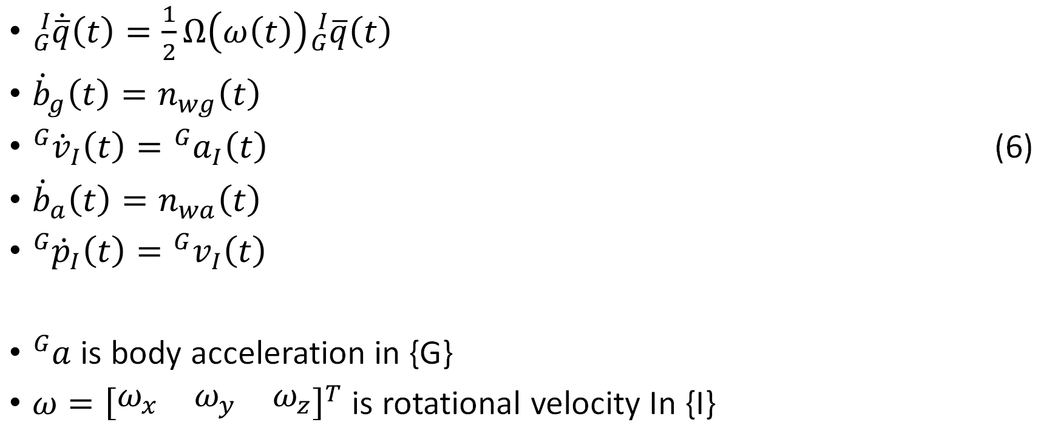
Continuous Time IMU Propagation Model
${}_{G}^{I}{\dot{\overline{q}}}\left(t\right)=\frac{1}{2}Ω\left(ω\left(t\right)\right){}_{G}^{I}{\overline{q}}\left(t\right)$
${\dot{b}}_{g}\left(t\right)=n_{wg}\left(t\right)$
${}_{ }^{G}{{\dot{v}}_{I}}\left(t\right)={}_{ }^{G}{a_{I}}\left(t\right)$ (6)
${\dot{b}}_{a}\left(t\right)=n_{wa}\left(t\right)$
${}_{ }^{G}{{\dot{p}}_{I}}\left(t\right)={}_{ }^{G}{v_{I}}\left(t\right)$
${}_{ }^{G}a$ is body acceleration in {G}
$ω={\left[\begin{matrix}ω_{x} & ω_{y} & ω_{z}\end{matrix}\right]}^{T}$ is rotational velocity In {I}
Notes:
Continuous Time IMU Propagation Model
Set of differential equations that describe
The evolving IMU state based on
The angular velocity and linear acceleration that
The IMU is measuring
Q dot is one half big omega of
the angular velocity times the current attitude
get to big omega
the change in biases are random Gaussian white noise
the rate of change of the velocity is acceleration in {G}
rate of change of position is the velocity in {G}

Slide 21

Continuous Time IMU Propagation Model
$Ω\left(ω\right)=\left[\begin{matrix}−\left\lfloor ω×\right\rfloor & ω \\ −ω^{T} & 0\end{matrix}\right]$
$\left\lfloor ω×\right\rfloor =\left[\begin{matrix}0 & −ω_{z} & ω_{y} \\ ω_{z} & 0 & {−ω}_{x} \\ −ω_{y} & ω_{x} & 0\end{matrix}\right]$
$Ω\left(ω\right)=\left[\begin{matrix}0 & ω_{z} & {−ω}_{y} & ω_{x} \\ {−ω}_{z} & 0 & ω_{x} & ω_{y} \\ ω_{y} & {−ω}_{x} & 0 & ω_{z} \\ −ω_{x} & −ω_{y} & −ω_{z} & 0\end{matrix}\right]$
Notes:
Continuous Time IMU Propagation Model
Big omega of little omega is
4 by 4 matrix of the skew-symmetric matrix
Formed from the angular velocity vector
With the angular velocities as shown

Slide 22
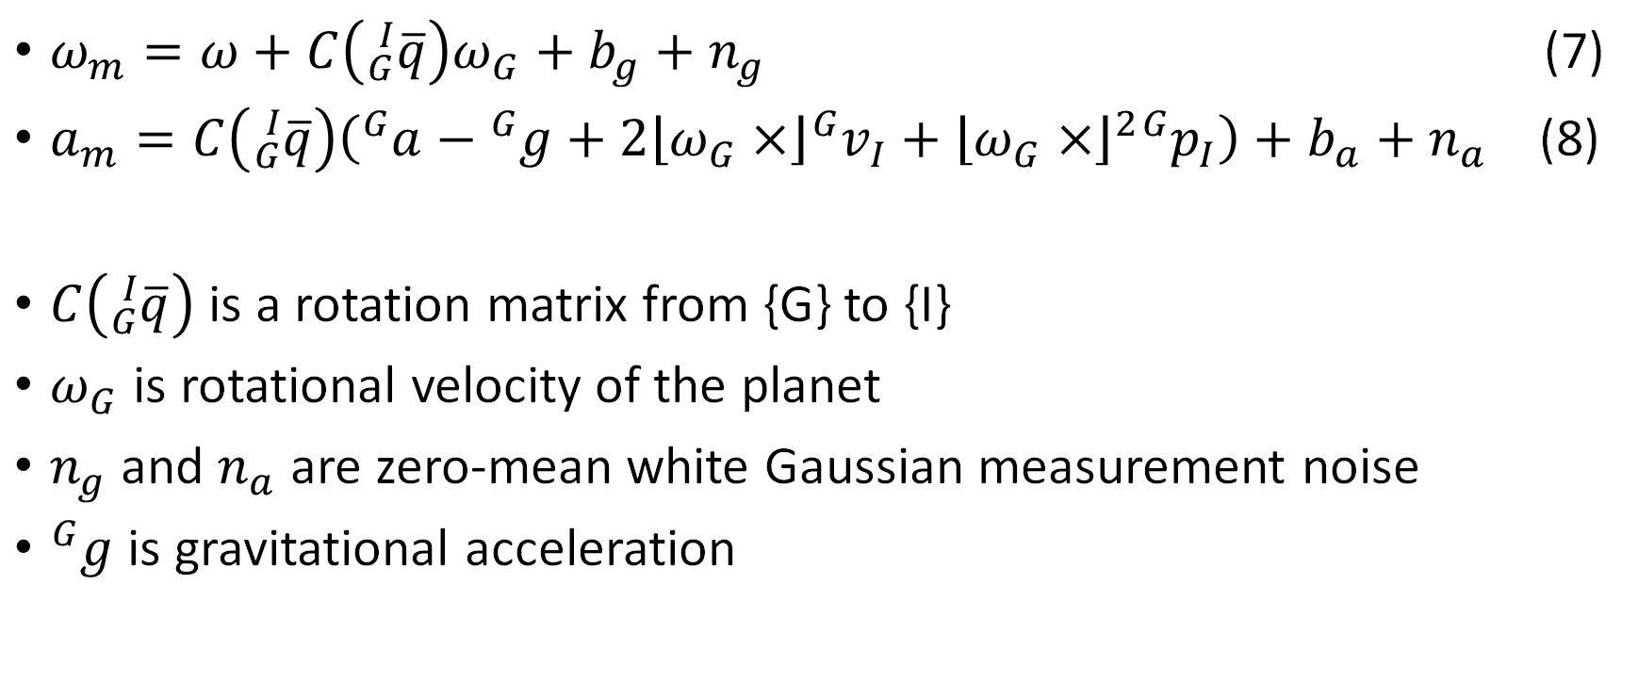
Gyroscope and Accelerometer Measurement Models
$ω_{m}=ω+C\left({}_{G}^{I}{\overline{q}}\right)ω_{G}+b_{g}+n_{g}$ (7)
$a_{m}=C\left({}_{G}^{I}{\overline{q}}\right)\left({}_{ }^{G}a−{}_{ }^{G}g+2\left\lfloor ω_{G}×\right\rfloor {}_{ }^{G}{v_{I}}+{\left\lfloor ω_{G}×\right\rfloor }^{2}{}_{ }^{G}{p_{I}}\right)+b_{a}+n_{a}$ (8)
$C\left({}_{G}^{I}{\overline{q}}\right)$ is a rotation matrix from {G} to {I}
$ω_{G}$ is rotational velocity of the planet
$n_{g}$ and $n_{a}$ are zero-mean white Gaussian measurement noise
${}_{ }^{G}g$ is gravitational acceleration
Notes:
Gyroscope and Accelerometer Measurement Models
The measured angular velocity is the actual angular velocity
Plus the angular velocity of Earth rotated to the IMU frame
Plus the gyroscope bias, plus some noise
C is a rotation matrix formed from a quaternion
The measured acceleration is the actual acceleration
Minus the acceleration due to gravity
Plus the accelerations felt by the IMU
From the earths rotation all rotated into the IMU frame
Plus the accelerometer bias, plus some noise

Slide 23

Continuous Time IMU Estimate Propagation
${}_{G}^{I}{\dot{\hat{\overline{q}}}}=\frac{1}{2}Ω\left(\hat{ω}\right){}_{G}^{I}{\hat{\overline{q}}}$
${\dot{\hat{b}}}_{g}=0_{3×1}$
${}_{ }^{G}{{\dot{\hat{v}}}_{I}}=C_{\hat{q}}^{T}\hat{a}−2\left\lfloor ω_{G}×\right\rfloor {}_{ }^{G}{{\hat{v}}_{I}}−{\left\lfloor ω_{G}×\right\rfloor }^{2}{}_{ }^{G}{{\hat{p}}_{I}}+{}_{ }^{G}g$ (9)
${\dot{\hat{b}}}_{a}=0_{3×1}$
${}_{ }^{G}{{\dot{\hat{p}}}_{I}}={}_{ }^{G}{{\hat{v}}_{I}}$
$C_{\hat{q}}=C\left({}_{G}^{I}{\overline{\hat{q}}}\right)$
$\hat{a}=a_{m}−b_{a}, \hat{ω}=ω_{m}−b_{g}−C_{\hat{q}}ω_{G}$
Notes:
Continuous Time IMU Estimate Propagation
Favorite variable q bar hat dot
The IMU estimate propagation equations same as before but
Now using estimated angular velocity
Which is the measured minus the bias and earths rotational velocity
Expected value has been applied to bias
Also estimated acceleration is used
Which is measured acceleration minus the bias,
And effects of earths rotation and gravity are removed

Slide 24
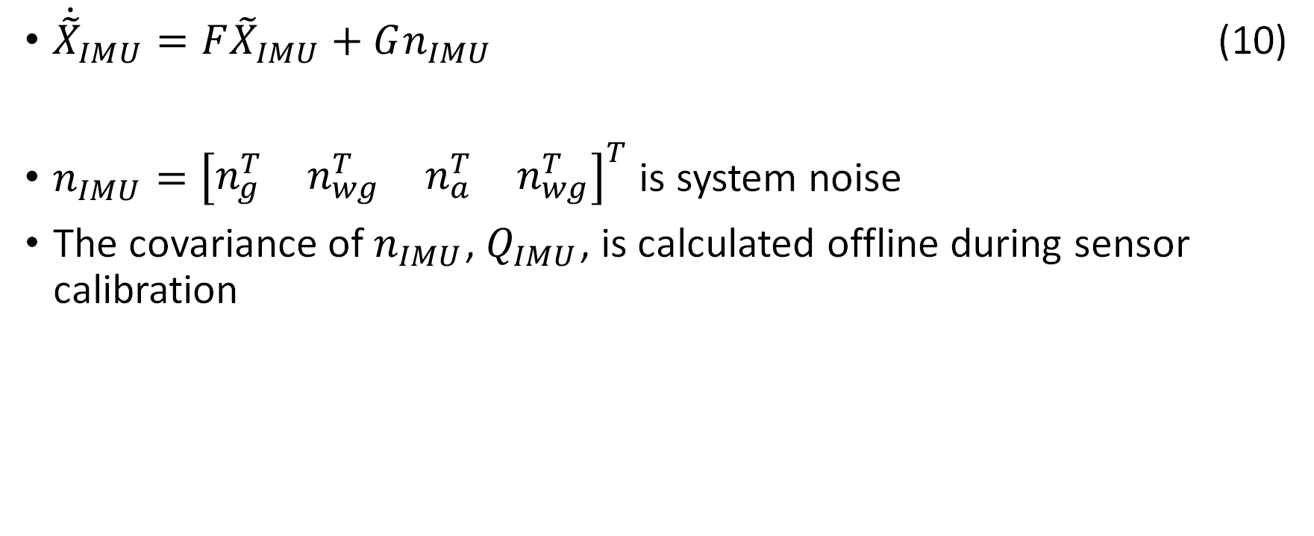
Linearized CT IMU Error-State Model
${\dot{\tilde{X}}}_{IMU}=F{\tilde{X}}_{IMU}+Gn_{IMU}$ (10)
$n_{IMU}={\left[\begin{matrix}n_{g}^{T} & n_{wg}^{T} & n_{a}^{T} & n_{wg}^{T}\end{matrix}\right]}^{T}$ is system noise
The covariance of $n_{IMU}$, $Q_{IMU}$, is calculated offline during sensor calibration
Notes:
Linearized CT IMU Error-State Model
Linearize error state by putting all those equations in F and G
And where N IMU is the system noise
With a covariance calculated offline during sensor calibration

Slide 25
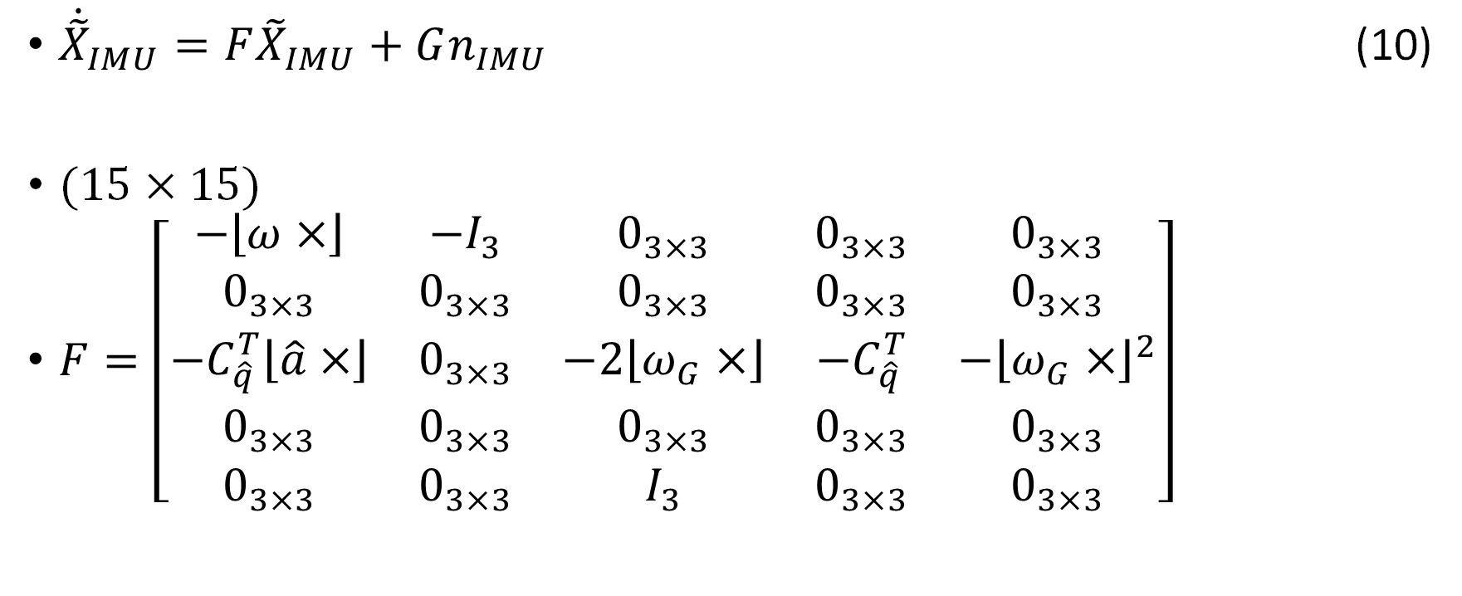
Linearized CT IMU Error-State Model
${\dot{\tilde{X}}}_{IMU}=F{\tilde{X}}_{IMU}+Gn_{IMU}$ (10)
(15 × 15)
$F=\left[\begin{matrix}−\left\lfloor ω×\right\rfloor & {−I}_{3} & 0_{3×3} & 0_{3×3} & 0_{3×3} \\ 0_{3×3} & 0_{3×3} & 0_{3×3} & 0_{3×3} & 0_{3×3} \\ −C_{\hat{q}}^{T}\left\lfloor \hat{a}×\right\rfloor & 0_{3×3} & −2\left\lfloor ω_{G}×\right\rfloor & −C_{\hat{q}}^{T} & −{\left\lfloor ω_{G}×\right\rfloor }^{2} \\ 0_{3×3} & 0_{3×3} & 0_{3×3} & 0_{3×3} & 0_{3×3} \\ 0_{3×3} & 0_{3×3} & I_{3} & 0_{3×3} & 0_{3×3}\end{matrix}\right]$
Notes:
Here is F to see expanded

Slide 26

Linearized CT IMU Error-State Model
${\dot{\tilde{X}}}_{IMU}=F{\tilde{X}}_{IMU}+Gn_{IMU}$ (10)
(12 × 12)
$G=\left[\begin{matrix}−I_{3} & 0_{3×3} & 0_{3×3} & 0_{3×3} \\ 0_{3×3} & I_{3} & 0_{3×3} & 0_{3×3} \\ 0_{3×3} & 0_{3×3} & −C_{\hat{q}}^{T} & 0_{3×3} \\ 0_{3×3} & 0_{3×3} & 0_{3×3} & 0_{3×3}\end{matrix}\right]$
Notes:
Here is G to see expanded

Slide 27
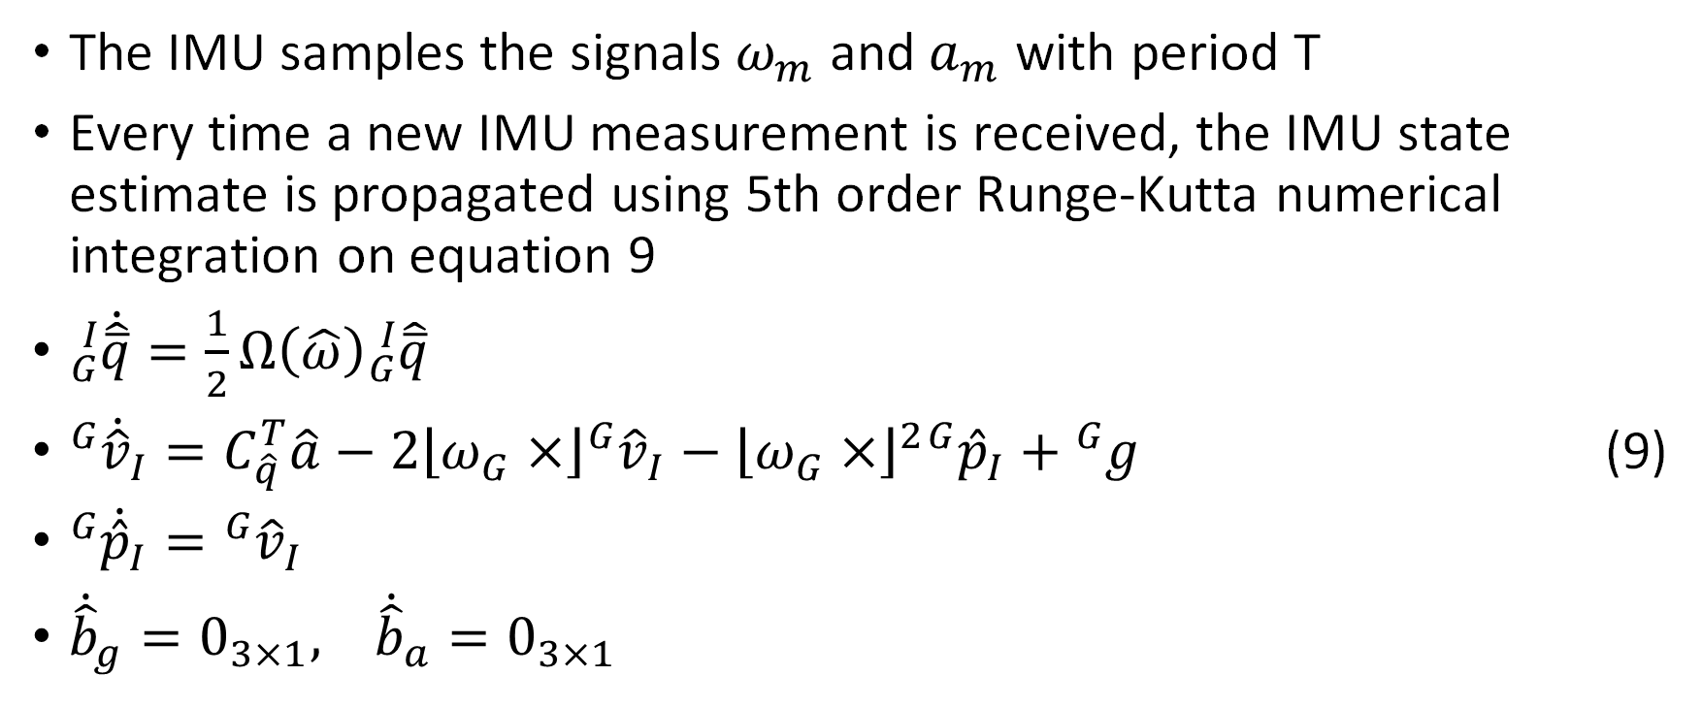
Discrete-Time IMU State Propagation
The IMU samples the signals $ω_{m}$ and $a_{m}$ with period T
Every time a new IMU measurement is received, the IMU state estimate is propagated using 5th order Runge-Kutta numerical integration on equation 9
${}_{G}^{I}{\dot{\hat{\overline{q}}}}=\frac{1}{2}Ω\left(\hat{ω}\right){}_{G}^{I}{\hat{\overline{q}}}$
${}_{ }^{G}{{\dot{\hat{v}}}_{I}}=C_{\hat{q}}^{T}\hat{a}−2\left\lfloor ω_{G}×\right\rfloor {}_{ }^{G}{{\hat{v}}_{I}}−{\left\lfloor ω_{G}×\right\rfloor }^{2}{}_{ }^{G}{{\hat{p}}_{I}}+{}_{ }^{G}g$ (9)
${}_{ }^{G}{{\dot{\hat{p}}}_{I}}={}_{ }^{G}{{\hat{v}}_{I}}$
${\dot{\hat{b}}}_{g}=0_{3×1}, {\dot{\hat{b}}}_{a}=0_{3×1}$
Notes:
Discrete time IMU state propagation
We are Working with discrete signals from IMU
Samples with period T
Discretize propagation equations
Every measurement made the estimate is propagated using
5th order Runge-Kutta numerical integration
On propagation differential equations
Written here again

Slide 28
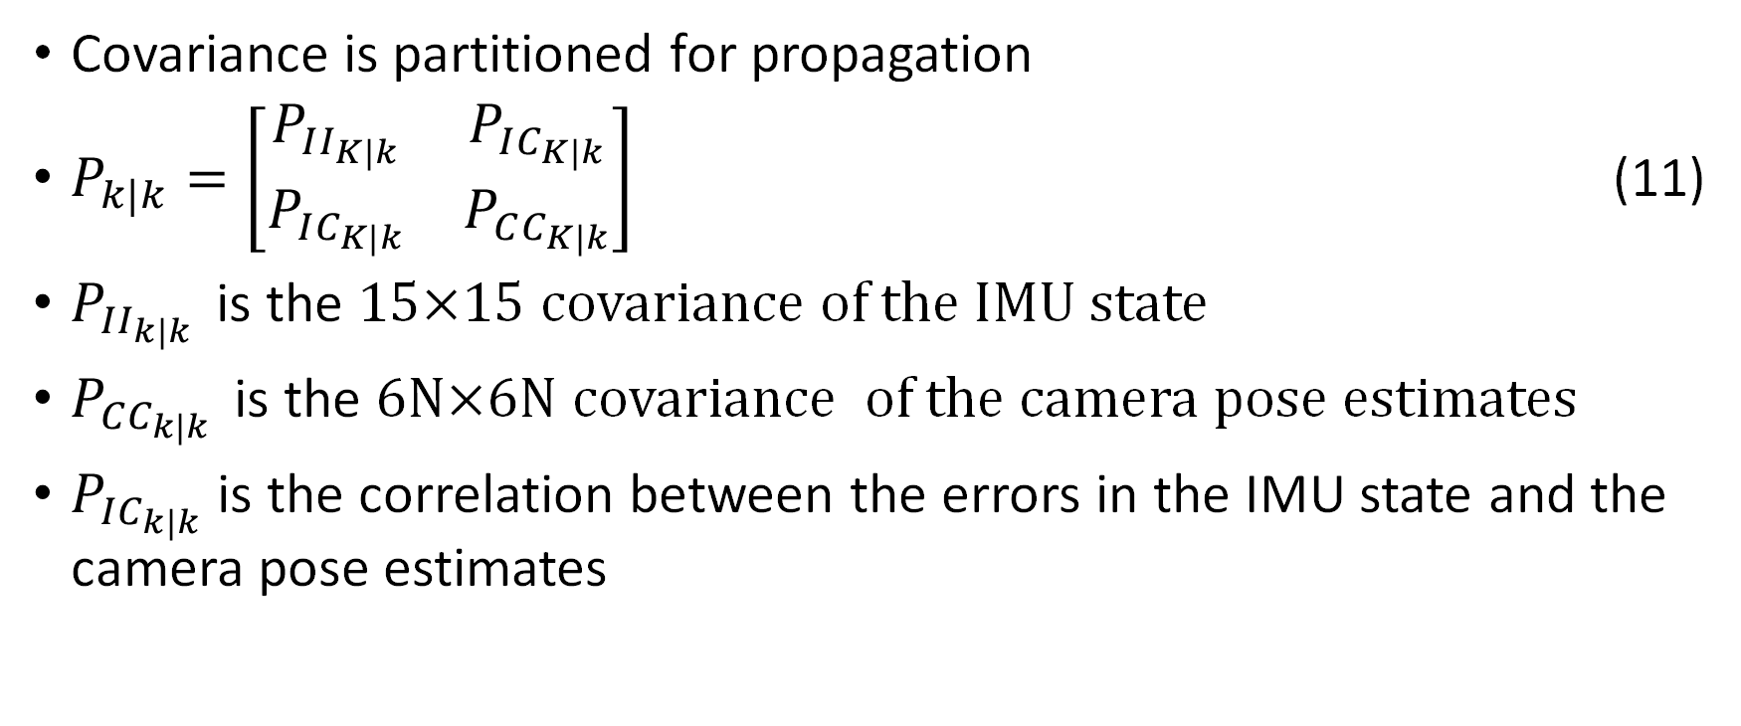
Discrete-Time IMU Covariance Propagation
Covariance is partitioned for propagation
$P_{k|k}=\left[\begin{matrix}P_{II_{K|k}} & P_{IC_{K|k}} \\ P_{IC_{K|k}} & P_{CC_{K|k}}\end{matrix}\right]$ (11)
$P_{II_{k|k }}$ is the 15×15 covariance of the IMU state
$P_{CC_{k|k }}$ is the 6N×6N covariance of the camera pose estimates
$P_{IC_{k|k}}$ is the correlation between the errors in the IMU state and the camera pose estimates
Notes:
Discrete-Time IMU Covariance Propagation
For propagation of IMU covariance
Covariance is partitioned since the camera poses are uninvolved
P I I is 15 by 15 covariance of IMU state
P C C is 6 N by 6 N covariance of camera poses
P I C is the correlation between the errors in the IMU state
and the camera pose estimates

Slide 29
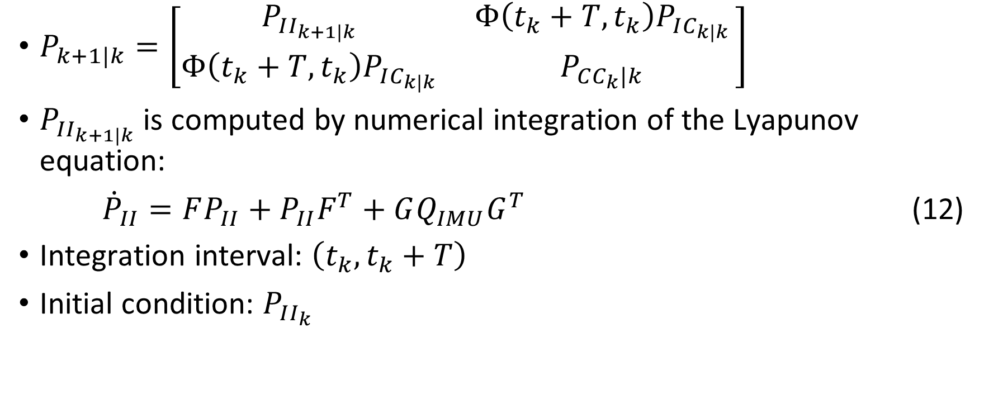
Discrete-Time IMU Covariance Propagation
$P_{k+1|k}=\left[\begin{matrix}P_{II_{k+1|k }} & Φ\left(t_{k}+T,t_{k}\right)P_{IC_{k|k }} \\ Φ\left(t_{k}+T,t_{k}\right)P_{IC_{k|k }} & P_{CC_{k}|k }\end{matrix}\right]$
$P_{II_{k+1|k}}$ is computed by numerical integration of the Lyapunov equation:
${\dot{P}}_{II}=FP_{II}+P_{II}F^{T}+GQ_{IMU}G^{T}$ (12)
Integration interval: $\left(t_{k}, t_{k}+T\right)$
Initial condition: $P_{II_{k}}$
Notes:
Discrete-Time IMU Covariance Propagation
Covarience propagation equation
P I I is propagated by numerical integration of the Lyapunov equation
Shown hear uses the
F matrix on previous IMU state covariance and
G matrix on uncertainty in IMU measurements
Integrated across time step
Initial condition is previous IMU state covariance

Slide 30
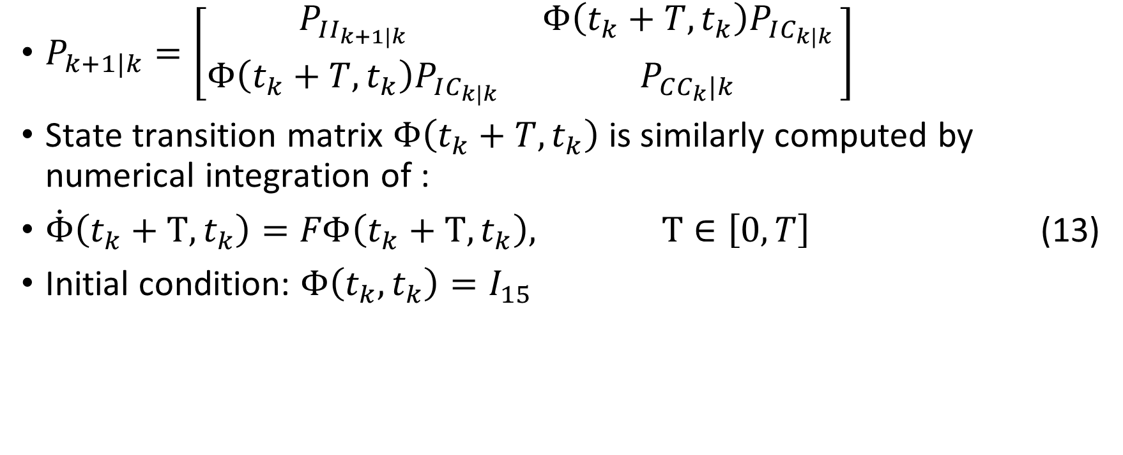
Discrete-Time IMU Covariance Propagation
$P_{k+1|k}=\left[\begin{matrix}P_{II_{k+1|k }} & Φ\left(t_{k}+T,t_{k}\right)P_{IC_{k|k }} \\ Φ\left(t_{k}+T,t_{k}\right)P_{IC_{k|k }} & P_{CC_{k}|k }\end{matrix}\right]$
State transition matrix $Φ\left(t_{k}+T,t_{k}\right)$ is similarly computed by numerical integration of :
$\dot{Φ}\left(t_{k}+Τ,t_{k}\right)=FΦ\left(t_{k}+Τ,t_{k}\right), Τ∈\left[0, T\right]$ (13)
Initial condition: $Φ\left(t_{k}, t_{k}\right)=I_{15}$
Notes:
Discrete-Time IMU Covariance Propagation
To propagate covariance between the IMU and camera poses
The state transition matrix big Phi is similarly computed by
numerical integration Of this differential equation
With initial condition identity matrix
The previous P I C is then multiplied by The state transition matrix to propagate

Slide 31
State Augmentation

Slide 32
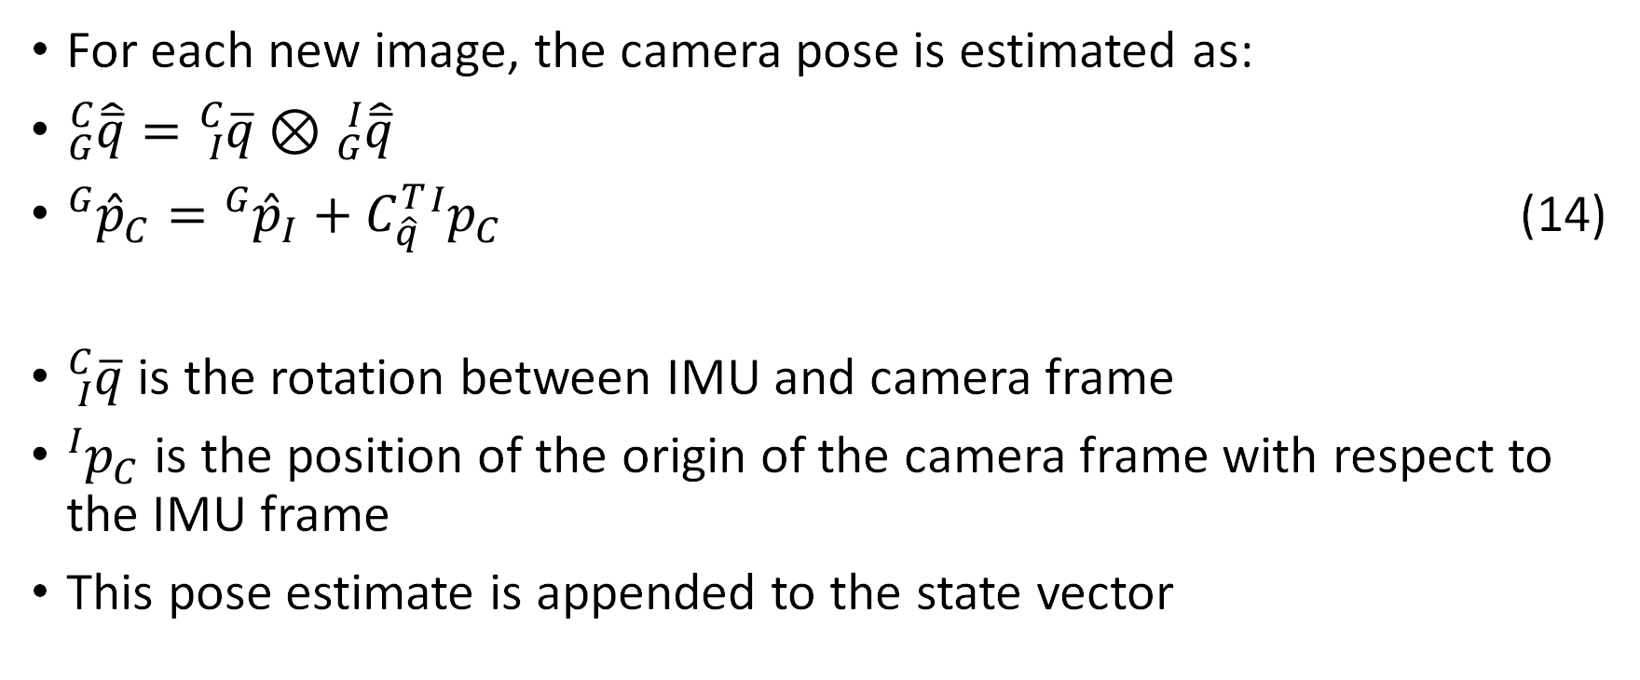
State Vector Augmentation
For each new image, the camera pose is estimated as:
${}_{G}^{C}{\hat{\overline{q}}}={}_{I}^{C}{\overline{q}}⊗{}_{G}^{I}{\hat{\overline{q}}}$
${}_{ }^{G}{{\hat{p}}_{C}}={}_{ }^{G}{{\hat{p}}_{I}}+C_{\hat{q}}^{T}{}_{ }^{I}{p_{C}}$ (14)
${}_{I}^{C}{\overline{q}}$ is the rotation between IMU and camera frame
${}_{ }^{I}{p_{C}}$ is the position of the origin of the camera frame with respect to the IMU frame
This pose estimate is appended to the state vector
Notes:
State Vector Augmentation
For each new image, the camera pose is estimated where
The estimated camera attitude is the
estimated IMU attitude rotated the camera frame
the estimated camera position is the estimated IMU position
plus the translation from the IMU to the camera
The rotation and translation are known quantities from calibration
this pose estimate is appended to the state vector

Slide 33

Covariance Augmentation
$P_{k|k }←\left[\begin{matrix}I_{6N+15} \\ J\end{matrix}\right]P_{k|k }{\left[\begin{matrix}I_{6N+15} \\ J\end{matrix}\right]}^{T}$ (15)
Where the Jacobian J is:
$J=\left[\begin{matrix}C\left({}_{I}^{C}{\overline{q}}\right) & 0_{3×9} & 0_{3×3} & 0_{3×6N} \\ \left\lfloor C_{\hat{q}}^{T}{}_{ }^{I}{P_{C}}×\right\rfloor & 0_{3×9} & I_{3} & 0_{3×6N}\end{matrix}\right]$ (16)
Notes:
Covariance Augmentation
Increased size of state vector need to increase size of covariance
The covariance becomes the original covariance
With this Jacobian J appended to the right and bottom
Here is what Jacobian looks like
Jacobian derived from equation 14 which
Was taking imu frame to camera frame

Slide 34
Measurement Model

Slide 35
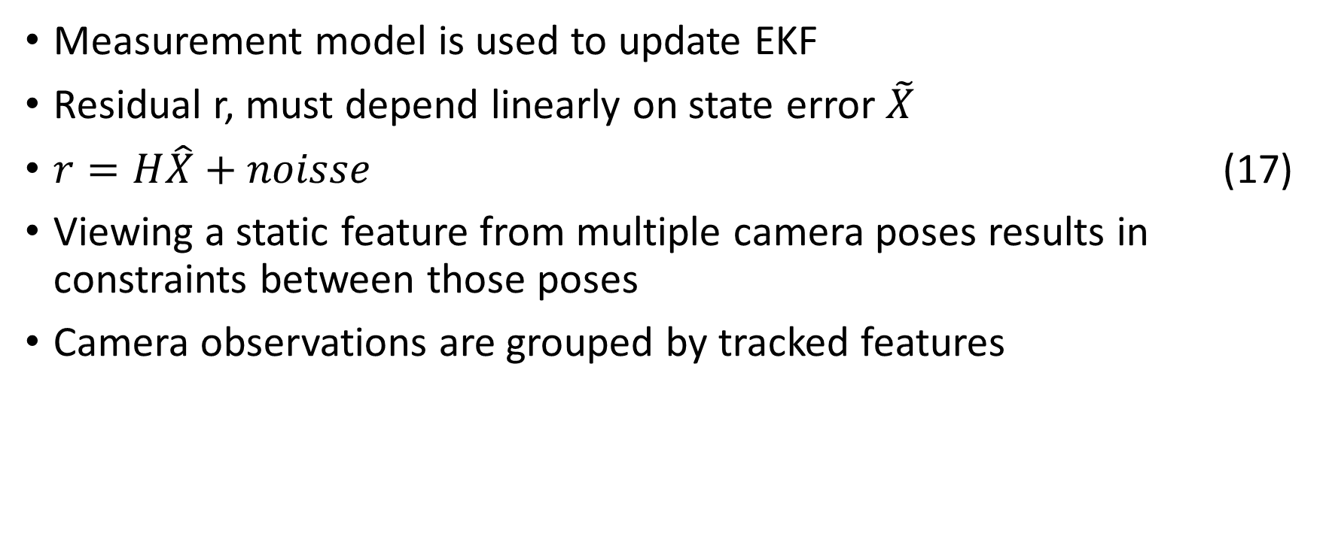
Measurement Model Setup
Measurement model is used to update EKF
Residual r, must depend linearly on state error $\tilde{X}$
$r=H\hat{X}+noisse$ (17)
Viewing a static feature from multiple camera poses results in constraints between those poses
Camera observations are grouped by tracked features
Notes:
Measurement Model Setup
Measurement model is used to update EKF
Residual r, must depend linearly on state error 𝑋 ̃
Which can be shown by this equation
Where H is the measurement Jacobian matrix and
The noise must be zero mean white uncorrelated with the state error
Viewing a static feature from multiple camera poses
results in constraints between those poses
Camera observations are grouped by tracked features

Slide 36
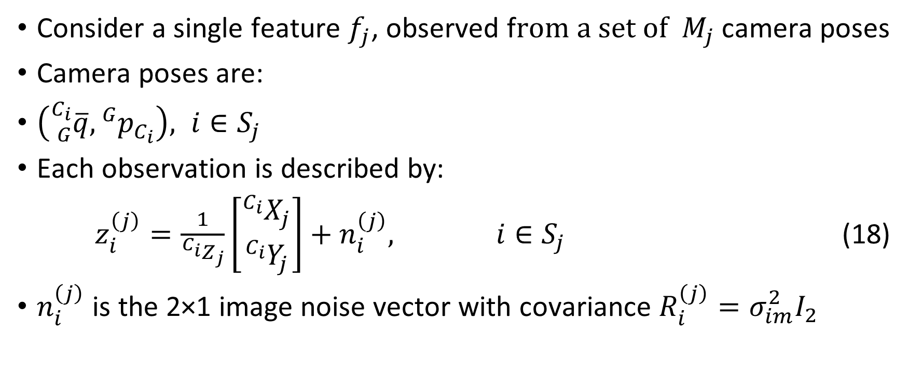
Explanation using a Single Feature
Consider a single feature $f_{j}$, observed f$rom a set of M_{j}$ camera poses
Camera poses are:
$\left({}_{G}^{C_{i}}{\overline{q}}, {}_{ }^{G}{p_{C_{i}}}\right), i∈S_{j}$
Each observation is described by:
$z_{i}^{\left(j\right)}=\frac{1}{{}_{ }^{C_{i}}{Z_{j}}}\left[\begin{matrix}{}_{ }^{C_{i}}{X_{j}} \\ {}_{ }^{C_{i}}{Y_{j}}\end{matrix}\right]+n_{i}^{\left(j\right)}, i∈S_{j}$ (18)
$n_{i}^{\left(j\right)}$ is the 2×1 image noise vector with covariance $R_{i}^{\left(j\right)}=σ_{im}^{2}I_{2}$
Notes:
Explanation using a Single Feature
Consider a single feature f j
Observed from m j camera poses
The camera poses of interest are the
Attitudes and positions of the camera where the feature was observed
Which are in the set S
Each observation of that feature is an
X Y coordinate from the image
Scaled by the distance from the camera Z
And plus some noise
With covariance R where the noise in X and Y are not correlated

Slide 37
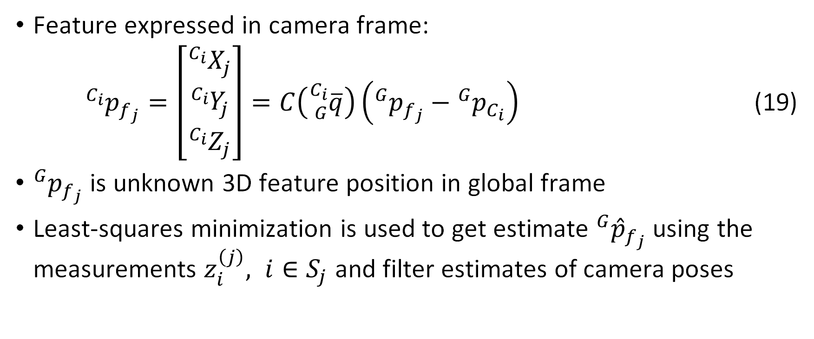
Feature Position Estimate
Feature expressed in camera frame:
${}_{ }^{C_{i}}{p_{f_{j}}}=\left[\begin{matrix}{}_{ }^{C_{i}}{X_{j}} \\ {}_{ }^{C_{i}}{Y_{j}} \\ {}_{ }^{C_{i}}{Z_{j}}\end{matrix}\right]=C\left({}_{G}^{C_{i}}{\overline{q}}\right)\left({}_{ }^{G}{p_{f_{j}}}−{}_{ }^{G}{p_{C_{i}}}\right)$ (19)
${}_{ }^{G}{p_{f_{j}}}$ is unknown 3D feature position in global frame
Least-squares minimization is used to get estimate ${}_{ }^{G}{{\hat{p}}_{f_{j}}}$ using the measurements $z_{i}^{\left(j\right)}, i∈S_{j}$ and filter estimates of camera poses
Notes:
Feature Position Estimate
Feature position in the camera frame
Is the X Y Z vector
Which is the position of the feature in {G}
Minus the position of the camera in {G}
Rotated from {G} to the camera frame
An estimate of the feature location is obtained
Using least square minimization of all observations of the feature
And the filter estimates of the camera poses
Where the observations were made

Slide 38

Measurement Residual
Measurement residual:
$r_{i}^{\left(j\right)}=z_{i}^{\left(j\right)}−{\hat{z}}_{i}^{\left(j\right)}$ (20)
Where
${\hat{z}}_{i}^{\left(j\right)}=\frac{1}{{}_{ }^{C_{i}}{{\hat{Z}}_{j}}}\left[\begin{matrix}{}_{ }^{C_{i}}{{\hat{X}}_{j}} \\ {}_{ }^{C_{i}}{{\hat{Y}}_{j}}\end{matrix}\right] ,\left[\begin{matrix}{}_{ }^{C_{i}}{X_{j}} \\ {}_{ }^{C_{i}}{Y_{j}} \\ {}_{ }^{C_{i}}{Z_{j}}\end{matrix}\right]=C\left({}_{G}^{C_{i}}{\hat{\overline{q}}}\right)\left({}_{ }^{G}{{\hat{p}}_{f_{j}}}−{}_{ }^{G}{{\hat{p}}_{C_{i}}}\right)$
Notes:
Measurement Residual
A measurement residual R is defined as
The observation minus the estimated observation
Where the estimated observation
Is calculated from the estimated global position of the feature
This is a 3D to 2D reprojection

Slide 39
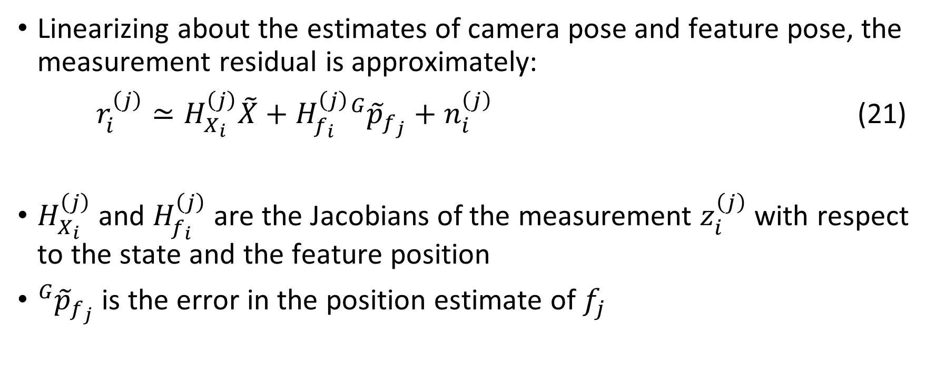
Linearized Measurement Residual
Linearizing about the estimates of camera pose and feature pose, the measurement residual is approximately:
$r_{i}^{\left(j\right)}≃H_{X_{i}}^{\left(j\right)}\tilde{X}+H_{f_{i}}^{\left(j\right)}{}_{ }^{G}{{\tilde{p}}_{f_{j}}}+n_{i}^{\left(j\right)}$ (21)
$H_{X_{i}}^{\left(j\right)}$ and $H_{f_{i}}^{\left(j\right)}$ are the Jacobians of the measurement $z_{i}^{\left(j\right)}$ with respect to the state and the feature position
${}_{ }^{G}{{\tilde{p}}_{f_{j}}}$ is the error in the position estimate of $f_{j}$
Notes:
Linearized Measurement Residual
Linearizing about the estimates of camera pose and
feature pose, the measurement residual is approximately
H X times the error state
Plus H F I times the error in feature position
Where H X and HF I are the Jacobians of
The measurement Z I with respect to
The state and feature position

Slide 40
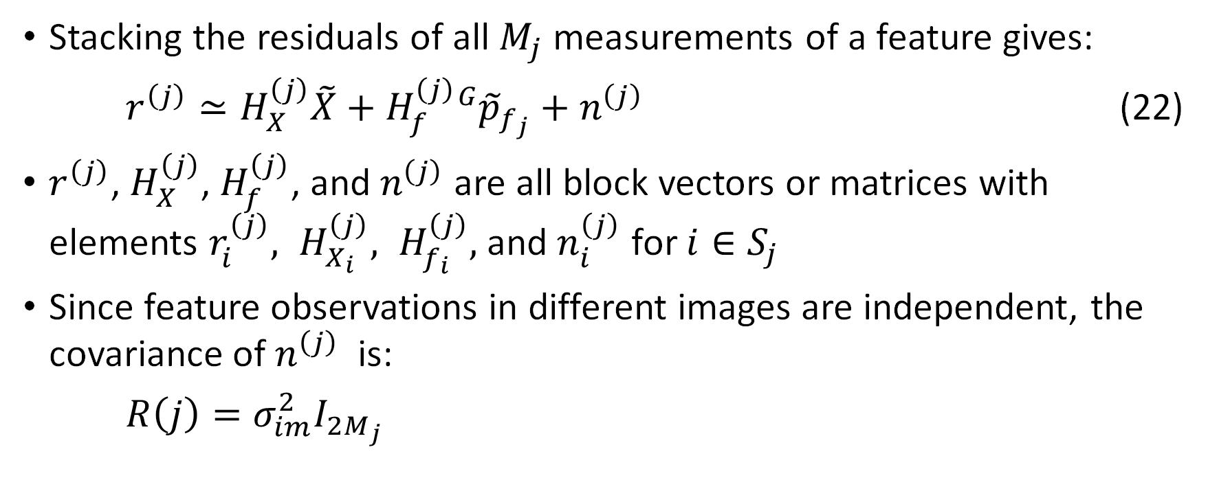
Residual Vector
Stacking the residuals of all $M_{j}$ measurements of a feature gives:
$r^{\left(j\right)}≃H_{X}^{\left(j\right)}\tilde{X}+H_{f}^{\left(j\right)}{}_{ }^{G}{{\tilde{p}}_{f_{j}}}+n^{\left(j\right)}$ (22)
$r^{\left(j\right)}$, $H_{X}^{\left(j\right)}$, $H_{f}^{\left(j\right)}$, and $n^{\left(j\right)}$ are all block vectors or matrices with elements $r_{i}^{\left(j\right)}, H_{X_{i}}^{\left(j\right)}, H_{f_{i}}^{\left(j\right)},$ and $n_{i}^{\left(j\right)}$ for $i∈S_{j}$
Since feature observations in different images are independent, the covariance of $n^{\left(j\right)}$ is:
$R\left(j\right)=σ_{im}^{2}I_{2M_{j}}$
Notes:
Residual Vector
Stacking the residuals of all M J measurements of a feature
Gives this equation which is just the vectors and matrices
stacked up for each observation of a feature
the observations of the feature are independent of
so the covariance is another sigma squared along the diagonal

Slide 41
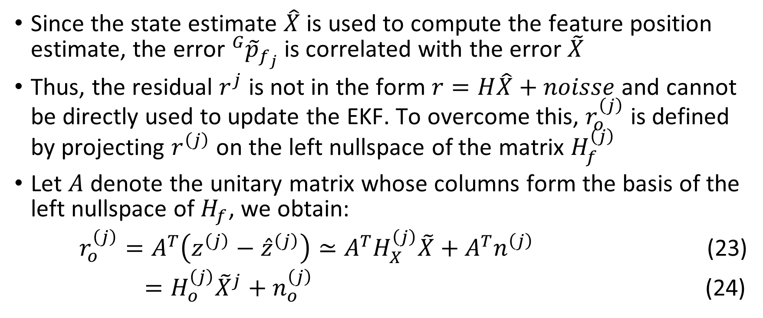
Residual Independent of Feature Pose Errors
Since the state estimate $\hat{X}$ is used to compute the feature position estimate, the error ${}_{ }^{G}{{\tilde{p}}_{f_{j}}}$ is correlated with the error $\tilde{X}$
Thus, the residual $r^{j}$ is not in the form $r=H\hat{X}+noisse$ and cannot be directly used to update the EKF. To overcome this, $r_{o}^{\left(j\right)}$ is defined by projecting $r^{\left(j\right)}$ on the left nullspace of the matrix $H_{f}^{\left(j\right)}$
Let $A$ denote the unitary matrix whose columns form the basis of the left nullspace of $H_{f}$, we obtain:
$r_{o}^{\left(j\right)}=A^{T}\left(z^{\left(j\right)}−{\hat{z}}^{\left(j\right)}\right)≃A^{T}H_{X}^{\left(j\right)}\tilde{X}+A^{T}n^{\left(j\right)}$ (23)
$=H_{o}^{\left(j\right)}{\tilde{X}}^{j}+n_{o}^{\left(j\right)}$ (24)
Notes:
Residual Independent of Feature Pose Errors
Since the state estimate is used
to compute the feature position estimate,
the error in the feature position estimate
is correlated with the error in the state
Thus, the residual is not in the linear form seen before
and cannot be directly used to update the EKF.
To overcome this, R O ) is defined
by projecting the residual vector on the
left nullspace of the matrix H f
Let 𝐴 denote the unitary matrix
whose columns form the basis
of the left nullspace of H F ,
we obtain this mess
which gives us H O and N O, the desired form
This residual is independent of the errors in the feature coordinates and
Therefore can be used for EKF updates
This defines a constraint between all
Camera poses where the feature was observed expressing
All available information from the observations
This means the resulting EKF update is optimal except
For linearization inaccuracies

Slide 42
EKF Update

Slide 43
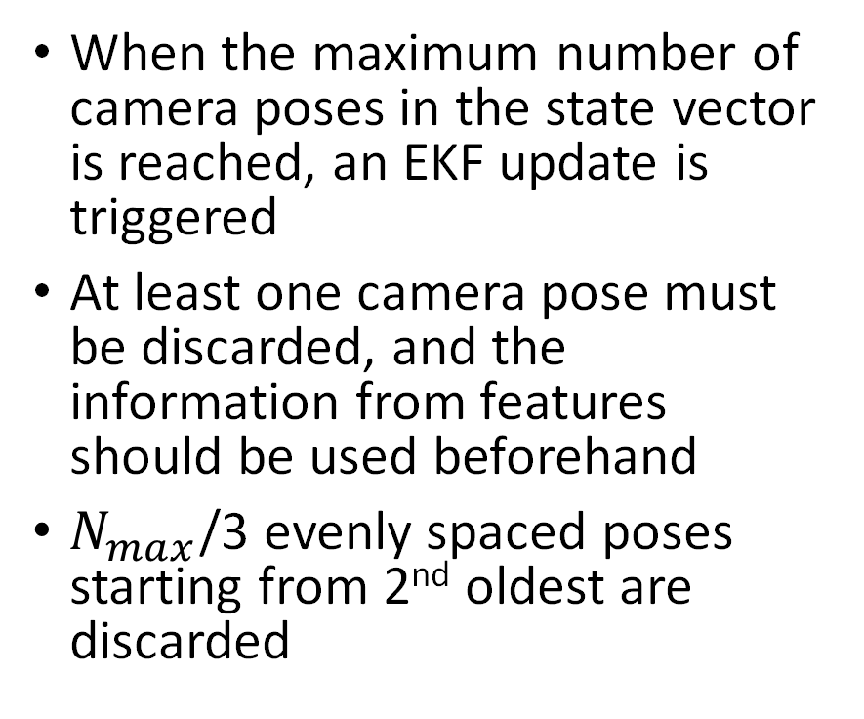
EKF Update Triggers
When a feature tracked over a number of images is no longer detected an update is triggered
All measurements of the feature are processed using the measurement model
This trigger occurs most often, as features move out of the camera’s field of view
When the maximum number of camera poses in the state vector is reached, an EKF update is triggered
At least one camera pose must be discarded, and the information from features should be used beforehand
$N_{max}$/3 evenly spaced poses starting from 2nd oldest are discarded
Notes:
Two events trigger an EKF update
First When a feature tracked over
a number of images is no longer detected
an update is triggered
All measurements of the feature
are processed using the measurement model
This trigger occurs most often,
as features move out of the camera’s field of view
second trigger When the maximum number of camera poses
in the state vector is reached,
an EKF update is triggered
At least one camera pose must be discarded,
and the information from features should be used beforehand
in their implementation one third of poses
evenly spaced starting from 2nd oldest are discarded
they found leaving the oldest pose helpful
because geometric constraints further back in time carry more information

Slide 44
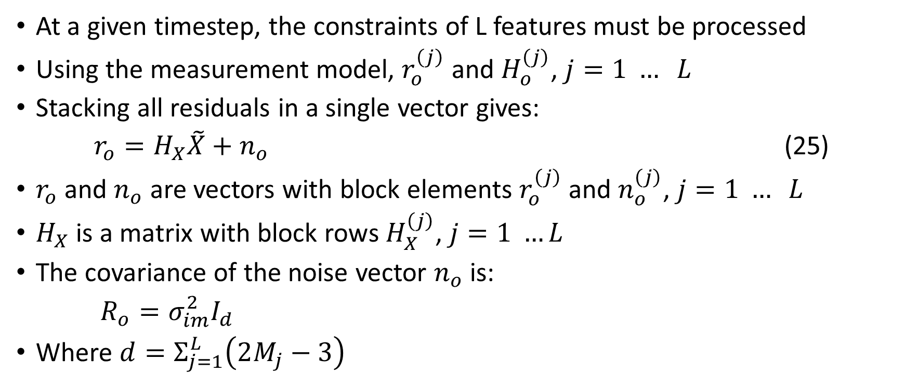
Update Procedure
At a given timestep, the constraints of L features must be processed
Using the measurement model, $r_{o}^{\left(j\right)}$ and $H_{o}^{\left(j\right)}$, $j=1 … L$
Stacking all residuals in a single vector gives:
$r_{o}=H_{X}\tilde{X}+n_{o}$ (25)
$r_{o}$ and $n_{o}$ are vectors with block elements $r_{o}^{\left(j\right)}$ and $n_{o}^{\left(j\right)}$, $j=1 … L$
$H_{X}$ is a matrix with block rows $H_{X}^{\left(j\right)}$, $j=1 …L$
The covariance of the noise vector $n_{o}$ is:
$R_{o}=σ_{im}^{2}I_{d}$
Where $d=Σ_{j=1}^{L}\left(2M_{j}−3\right)$
Notes:
Update Procedure
At a given timestep,
the constraints of L features must be processed
Using the measurement model, the residual R O of J
and H O of J are calculated for each feature
all residuals are then stacked into one vector
The covariance of the noise vector N O is:
Is yet another diagonal of variances
Where the dimension D is
The sum across all features of
Twice the number of observations of that feature minus three

Slide 45
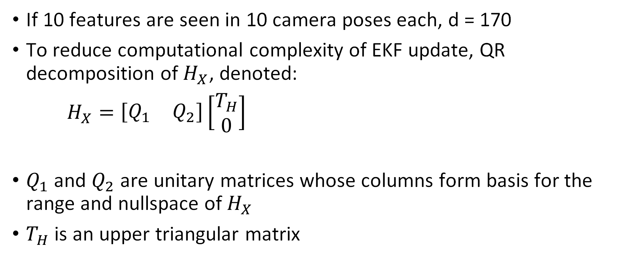
Computation Reduction
If 10 features are seen in 10 camera poses each, d = 170
To reduce computational complexity of EKF update, QR decomposition of $H_{X}$, denoted:
$H_{X}=\left[\begin{matrix}Q_{1} & Q_{2}\end{matrix}\right]\left[\begin{matrix}T_{H} \\ 0\end{matrix}\right]$
$Q_{1}$ and $Q_{2}$ are unitary matrices whose columns form basis for the range and nullspace of $H_{X}$
$T_{H}$ is an upper triangular matrix
Notes:
Computation Reduction
For example if 10 features are tracked across 10 images
D equals 170
To reduce computational complexity of EKF update
The H X is decomposed using QR decomposition
This splits the matrix into 3 matrices
Q one Q two and T H

Slide 46
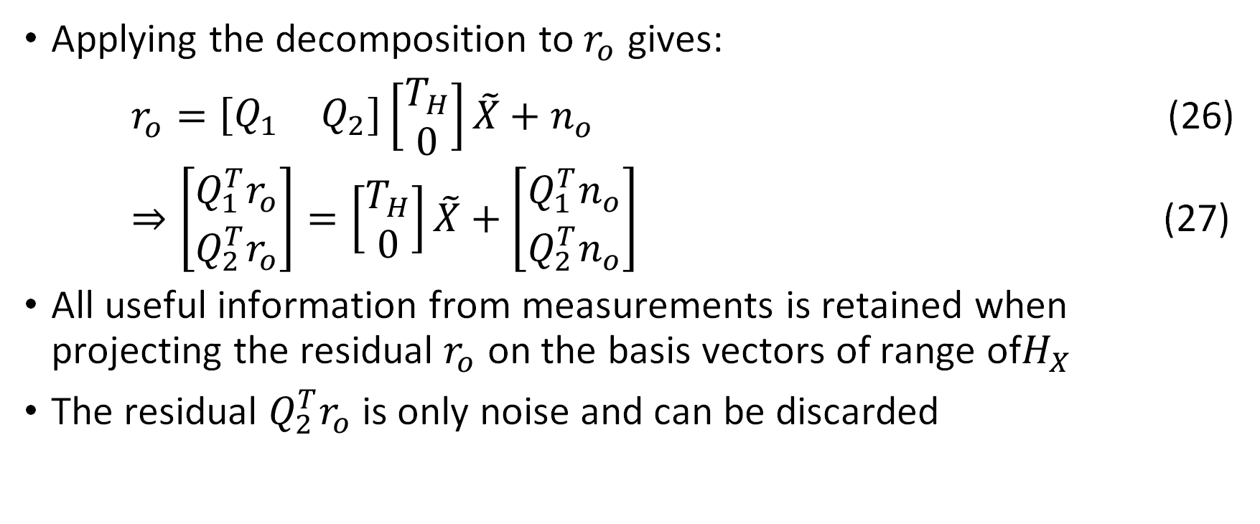
Decomposed Residual
Applying the decomposition to $r_{o}$ gives:
$r_{o}=\left[\begin{matrix}Q_{1} & Q_{2}\end{matrix}\right]\left[\begin{matrix}T_{H} \\ 0\end{matrix}\right]\tilde{X}+n_{o}$ (26)
$⇒\left[\begin{matrix}Q_{1}^{T}r_{o} \\ Q_{2}^{T}r_{o}\end{matrix}\right]=\left[\begin{matrix}T_{H} \\ 0\end{matrix}\right]\tilde{X}+\left[\begin{matrix}Q_{1}^{T}n_{o} \\ Q_{2}^{T}n_{o}\end{matrix}\right]$ (27)
All useful information from measurements is retained when projecting the residual $r_{o}$ on the basis vectors of range of$H_{X}$
The residual $Q_{2}^{T}r_{o}$ is only noise and can be discarded
Notes:
Decomposed Residual
Applying the decomposition of H O to the residual
Gives this equation which can be separated into
Parts with Q 1 and Q 2
The residual with Q 2 is just noise since
The state estimate has a coefficient of zero and can be discarded

Slide 47
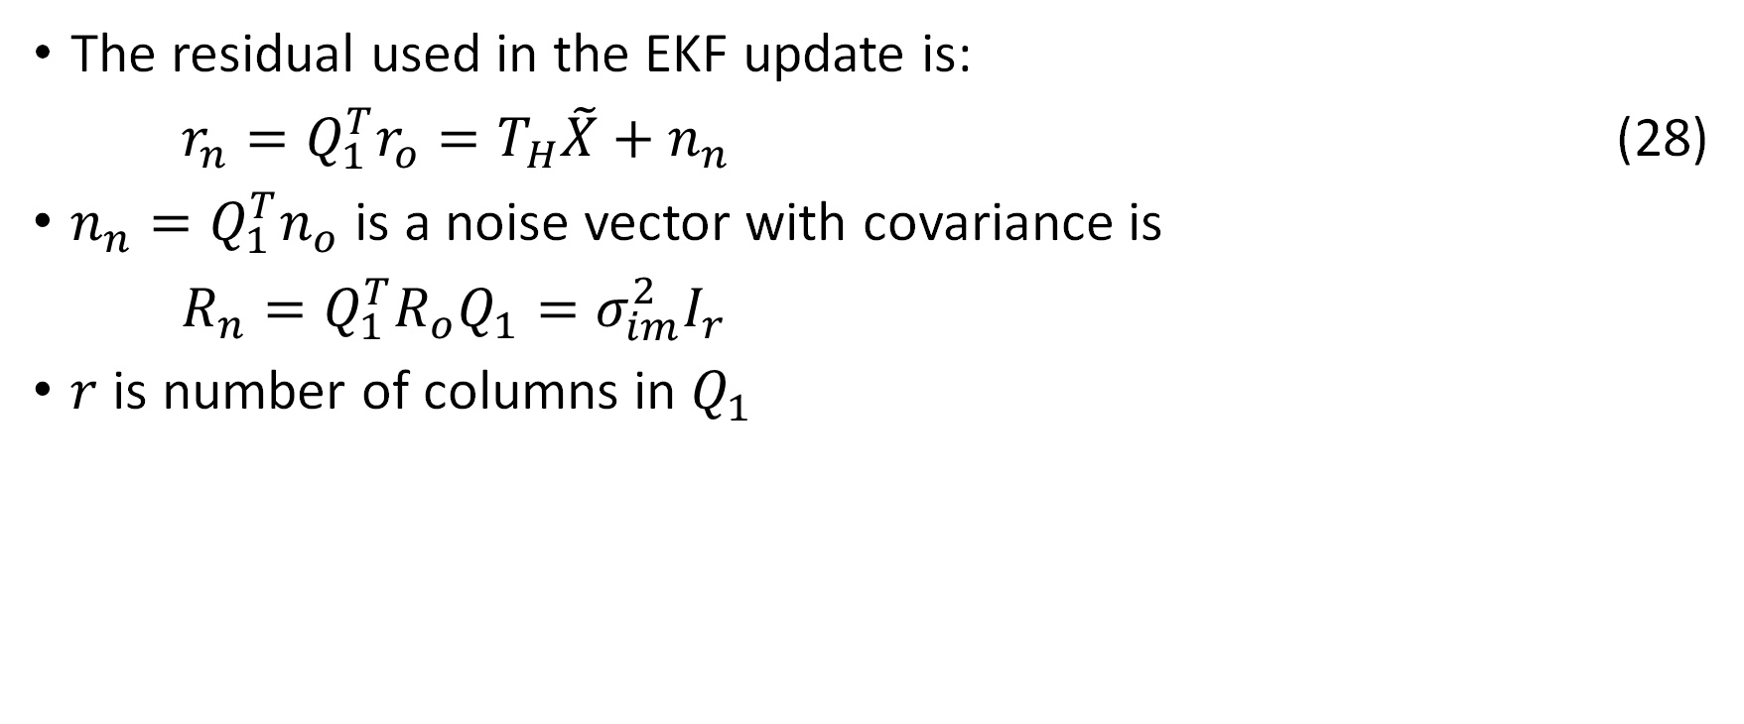
EKF Update Residual
The residual used in the EKF update is:
$r_{n}=Q_{1}^{T}r_{o}=T_{H}\tilde{X}+n_{n}$ (28)
$n_{n}=Q_{1}^{T}n_{o}$ is a noise vector with covariance is
$R_{n}=Q_{1}^{T}R_{o}Q_{1}=σ_{im}^{2}I_{r}$
$r$ is number of columns in $Q_{1}$
Notes:
EKF Update Residual
Finally, the residual used for EKF updates is given
As r n and is a function of Q 1 and the residual R O
The covariance of R N simplifies
To just another diagonal of image variances

Slide 48
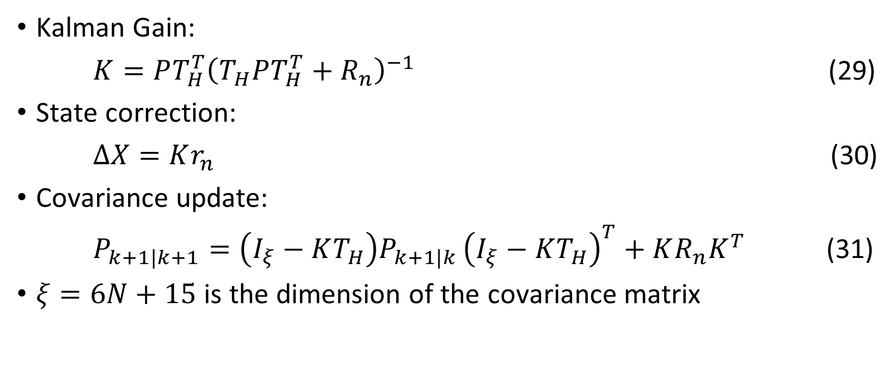
The Update
Kalman Gain:
$K=PT_{H}^{T}{\left(T_{H}PT_{H}^{T}+R_{n}\right)}^{−1}$ (29)
State correction:
$ΔX=Kr_{n}$ (30)
Covariance update:
$P_{k+1|k+1}=\left(I_{ξ}−KT_{H}\right)P_{k+1|k }{\left(I_{ξ}−KT_{H}\right)}^{T}+KR_{n}K^{T}$ (31)
$ξ=6N+15$ is the dimension of the covariance matrix
Notes:
The Update
The Kalman gain is calculated from the covariance
T H which was from the residual
And the residual covariance R N
The state correction is the Kalman gain
Times the residual r n
And covariance update using this equation with
The Kalman gain, T H from decomposed residual
The previous covariance and the covariance of the residual

Slide 49
Discussion

Slide 50
Computational Complexity
Linear in number of observed features
At most cubic in number of camera poses included in state
Number of poses is most significant factor for computational cost
Tunable parameter which can be adjusted to fit computational power
Notes:
Computational Complexity
Linear in number of observed features
At most cubic in number of camera poses included in state
Number of poses is most significant factor for computational cost
Tunable parameter which can be adjusted to fit computational power

Slide 51
Robustness to Linearization Inaccuracies
Two characteristics of the algorithm increase its robustness to linearization inaccuracies:
  the inverse feature depth parametrization used in the measurement model
  the delayed linearization of measurements
Notes:
Robustness to Linearization Inaccuracies
Two characteristics of the algorithm
increase its robustness to linearization inaccuracies:
the inverse feature depth parametrization
used in the measurement model
See appendix for explanation
delayed linearization of measurements

Slide 52
Optimal for Many Features
Two kinds of features:
  Opportunistic Features – tracked over a small number of frames
  Persistent Features – tracked over long period of time or when revisited
Opportunistic features are far more common
If all poses a feature is detected are in the state, the measurement model is optimal except for linearization inaccuracies
Therefore, the algorithm is able to optimally use localization information of opportunistic features
Notes:
Optimal for Many Features
Two kinds of features:
Opportunistic Features –
tracked over a small number of frames
Persistent Features –
tracked over long period of time or when revisited
Opportunistic features are far more common
Features are lost due to limited field of view
Change in viewpoint, or noise
Since If all poses a feature is detected
are in the state, the measurement model
is optimal except for linearization inaccuracies
Therefore, the algorithm is able to
optimally use localization information of
opportunistic features

Slide 53
Experimental Results

Slide 54
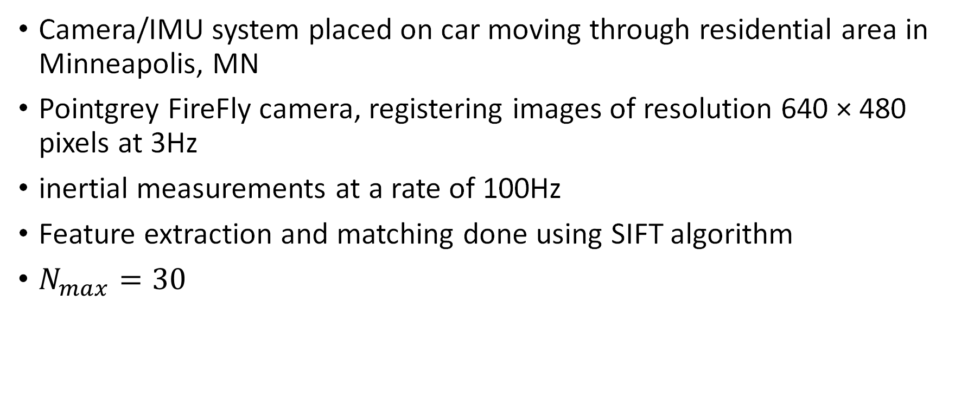
Experiment Setup
Camera/IMU system placed on car moving through residential area in Minneapolis, MN
Pointgrey FireFly camera, registering images of resolution 640 × 480 pixels at 3Hz
inertial measurements at a rate of 100Hz
Feature extraction and matching done using SIFT algorithm
$N_{max}=30$
Notes:
Experiment setup
Camera/IMU system placed on car moving
through residential area in Minneapolis, MN
Pointgrey FireFly camera,
registering images of resolution 640 × 480 pixels at 3Hz
inertial measurements at a rate of 100Hz
For experiment data was recorded and processed offline
Feature extraction and matching done
using SIFT algorithm
maximum number of camera poses in state vector was 30
Found that features were rarely tracked over more than 30 frames and
Therefore most available constraints were captured

Slide 55
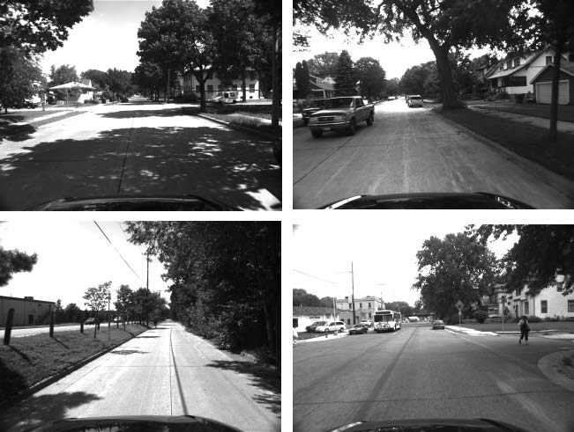
Example Images

Slide 56
Results
Dataset processed at 14Hz on a single core of a 2GHz processor
Since the start and end pose were known, the final position error was calculated to be approximately 10m
0.31% error over the 3.2km trajectory
No loop closure or nonholonomic constraints
Notes:
Results
Dataset processed at 14Hz
on a single core of a 2GHz processor
Since the start and end pose were known,
the final position error was calculated to be approximately 10m
0.31% error over the 3.2km trajectory
No loop closure or nonholonomic constraints

Slide 57
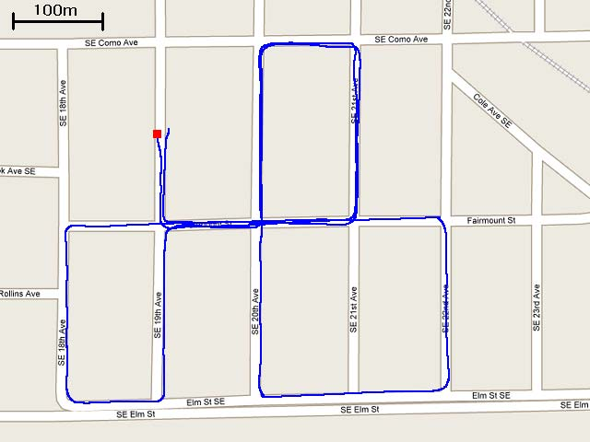
Trajectory

